Slide 1
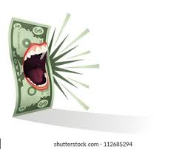
MoneyTalks

Slide 2
We all like ‘Money’
We all like money but sometimes we wonder where our money ends up. How did I go from having money, to having some money then having no money (┬┬﹏┬┬)
Intentionally spending money is a must but sometimes we just look at our current balance and wonder how did my finances end up like that.
Even worse are hidden transactions where they just end up on you without your knowledge

Slide 3
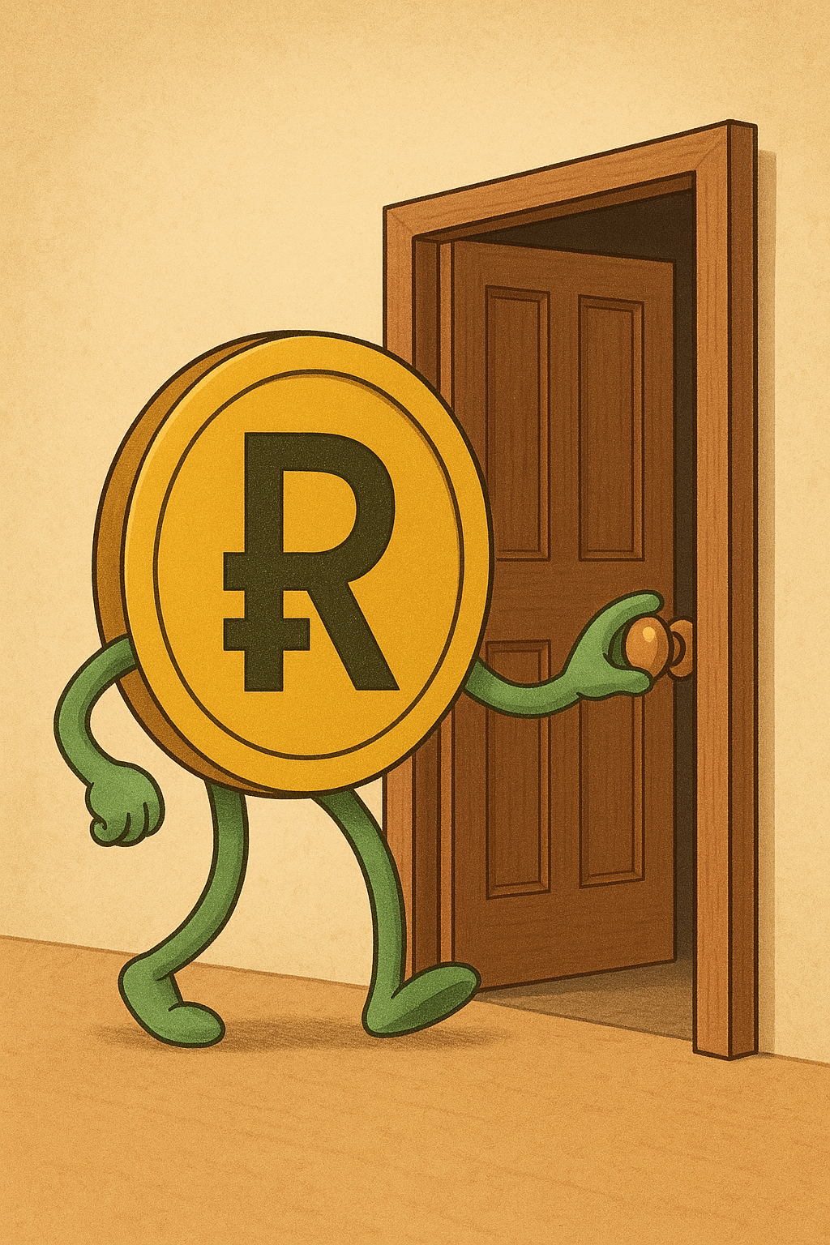
Enter MoneyTalks

Slide 4
What is MoneyTalks
MoneyTalks is a an app which gives detailed descriptions of how your money is spent, where it goes and a short description of how it affects you financially
It also provides a virtual wallet of how u would want to spend money instead.
This includes all the sneaky purchases that companies or individuals(including banks) that take from you.

Slide 5
Watch the Video Presentation

Slide 6
Done Watching?
Don’t be disappointed by the lack of development that went into this but be ready for these idea’s to take shape and fly us into the next technological generation

